Slide 1
IPAG Infrastructure Inventory Build -Samba Reddy ☺

Slide 2
Agenda
Overview
Flow diagrams
Devices
E2E Application Flow
Rules
Question & Answers

Slide 3
IPAG -Overview
What is IPAG?
Next Generation IP Based Network
IPAG stands for Internet Protocol Aggregation and is the next generation At&t network architecture. The new infrastructure will enable and support multiple business and consumer services including support for Cell Site Backhaul services. Among those services are OEM-AC (now its ASE),OEW, MIS, PNT, AVPN as well as many others in the future
IPAG consists of 1) Service Delivery 2) Service Assurance
As a Name implies IPAG Service Delivery is a set of applications containing the functionality necessary to deliver service to the customer
IPAG Service Assurance consists of monitoring the IPAG network for faults as well as to properly maintain service levels.
IPAG Service Delivery consists of
Pre-sale
Ordering
Provisioning

Slide 4
Inventory Build Overview
Inventory build
Inventory build is part of provisioning in Service Delivery
Purpose : Before any services can be sold the IPAG Network MUST be in place
The IPAG Network Infrastructure consists of the IPAG1, IPAG2, TA5000, EMUX ,VPLS-PE devices plus the links between them. To begin the process of the inventory
build an IPAG Cluster is first built. The IPAG Cluster will then contain the IPAG
Network and will contain devices ONLY within the same Metro Area or LATA (Local
Access and Transport Area). They are two types of links
INL (Inter -Nodal Link-Fiber)
The links between the IPAG infrastructure network devices are called INLs (Ex: Links between IPAG1 to IPAG 2 or IPAG 1 to TA5K or IPAG2 to EMUX ). The INLs are Fiber connections and can be either in the same Serving Wire Center (SWC) or Central Office (CO) or in different SWCs/COs as long as they’re in the same LATA(Local Access and Transport Area).
CNL (Customer Nodal Link - Fiber)
The Links between IPAG Infrastructure network devices and Network Termination Equipment ( NTEs) are called CNLs (Ex :Links between NTE to IPAG)
note :NTEs are placed in customer premises and its owned by At&t

Slide 5
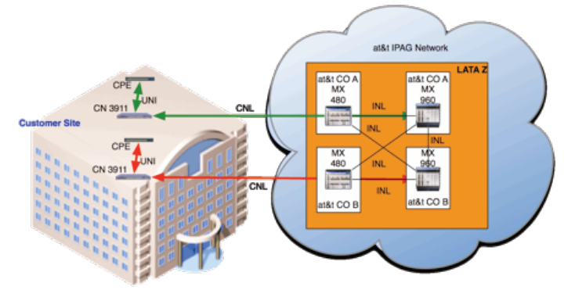
Flow Diagram

Slide 6
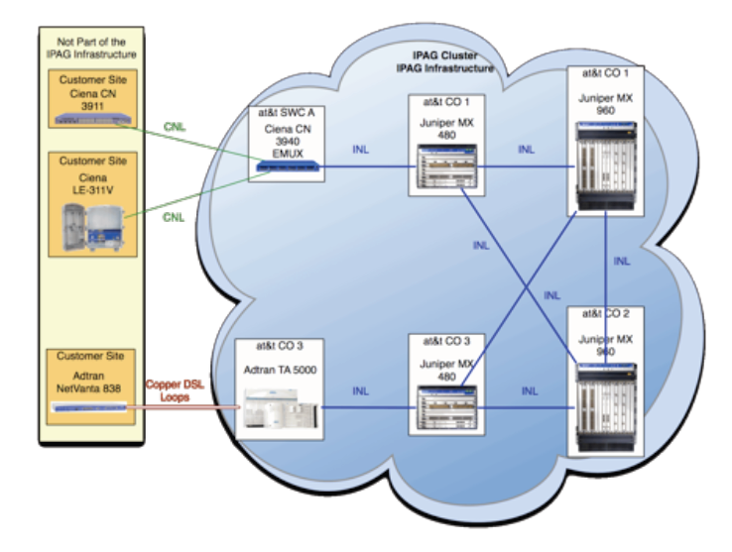
IPAG Infrastructure Cluster

Slide 7
Devices
Real and Phantom Devices are using to build the INL/CNL Links in canopi GUI
For Phantom devices we need to do Equipment rollout for built the devices in the Canopi & Cramer systems and the real devices are already built in the systems , so not required equipment rollout
List of INL Links between devices
Links between IPAG1 (MX480) <-> IPAG 2 (MX960) -10 GE bandwidth Speed
Links between IPAG 1(MX480) <-> IPAG 1(MX480)-1 GE bandwidth speed
Links between IPAG 2 (MX960)<->IPAG 2 (MX960)-10 GE bandwidth speed
Links between EMUX<->IPAG1(MX480)-1 GE bandwidth speed
Links between TA5000<->IPAG1(MX480)-1 GE bandwidth Speed
Links between VPLS-PE <->IPAG2(MX960)-10 GE bandwidth speed
List of CNL Links between the devices
Links between any Ciena NTE devices <-> IPAG1 -1 GE bandwidth speed
Links between any Ciena NTE devices <-> IPAG 2 -10 GE bandwidth speed
Links between any Ciena NTE devices <-> EMUX -1 GE bandwidth speed
Links between any Ciena NTE devices <-> TA5000 ( Canopi GUI is not supported)

Slide 8
INL/CNL E2E FLOW
Request
Request
Request
Response Response
CANOPI
Inventory Build consists of
INL/CNL Order creation
PO & TOs are generated
INLs/CNL s Provisioning
Order /activation Completion
Cramer
Inventory system-
INL/CNL Circuits are active & In- service
Create Ports
TIRKS
Work Flow
Create Facility
Create Post Facility
purchase
SFP
PIE / YODA
Clo creation request & Clo completion response
TIRKS(design work order request word doc)
Order completion
MMI
Lag port activation
WFA completion(
Technicians to perform to activate Uni circuits)
LPP/INSTAR(Port & cramer details to configure IPAG router)

Slide 9
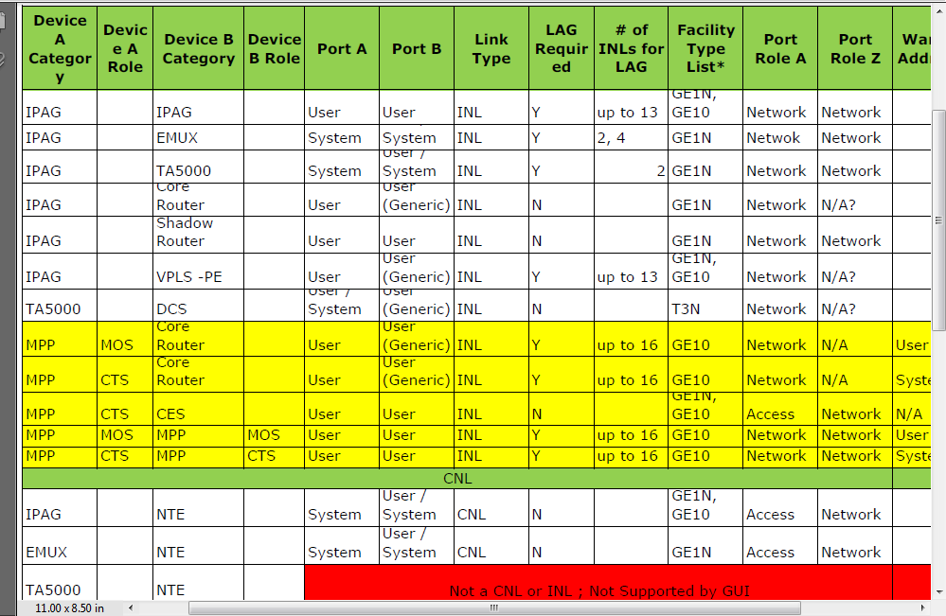
CNL/INL/LAG rules

Slide 10

Question & Answers

Slide 11


